Slide 1




#RintisKarirImpian
Portofolio - Intensive Bootcamp
SQL For Data Analysis 1
Owner: Muhammad Ridho Muhajir

Slide 2
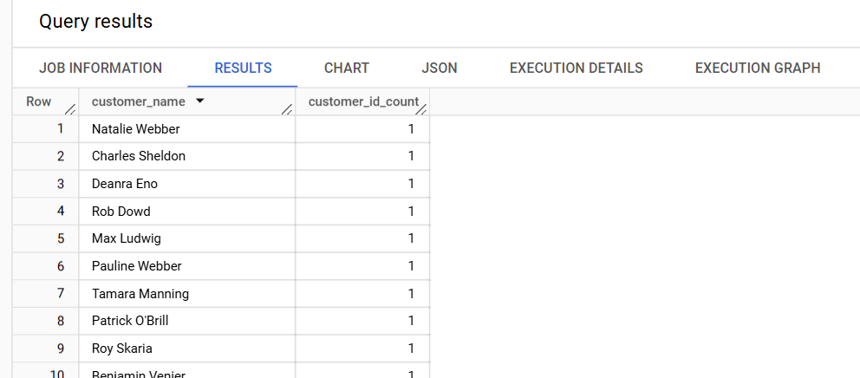

SQL for Data Analysis 1
Buktikan bahwa satu nama konsumen hanya memiliki satu customer id!
Query:
select customer_name, count(distinct customer_id) customer_id_count
from `tokopaedi.orders`
group by customer_name
#RintisKarirImpian

Slide 3
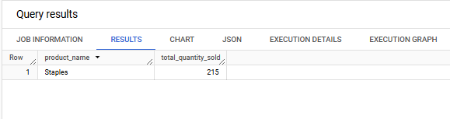
SQL for Data Analysis 1
Produk (product_name) apa yang paling best selling secara kuantitas
Query:
select product_name, sum(quantity) total_quantity_sold
from `tokopaedi.orders`
group by product_name
order by total_quantity_sold desc
limit 1
#RintisKarirImpian

Slide 4
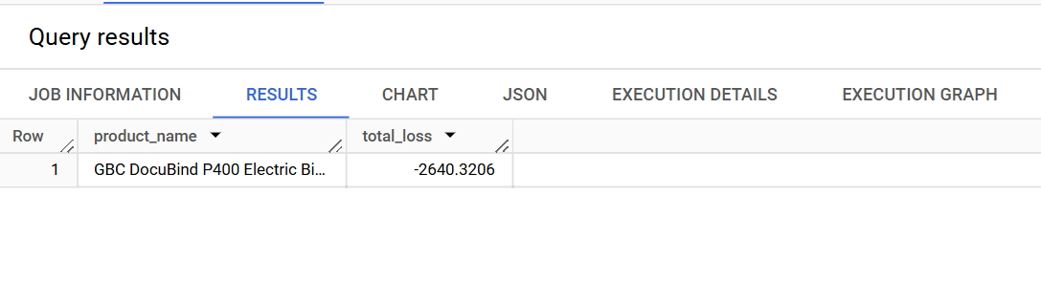
SQL for Data Analysis 1
Produk apa yang paling merugikan selama tahun 2017
Query:
select product_name, sum(profit) total_loss
from `tokopaedi.orders`
where extract(year from order_date) = 2017
group by product_name
order by total_loss asc
limit 1
#RintisKarirImpian

Slide 5
Terima Kasih
Build your skill and portfolio via myskill.id/bootcamp
#RintisKarirImpian

